Slide 1







Slide 2
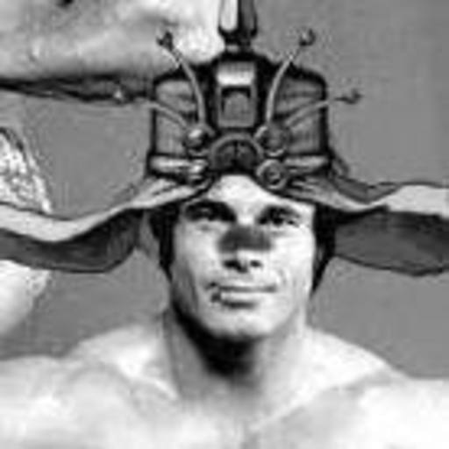


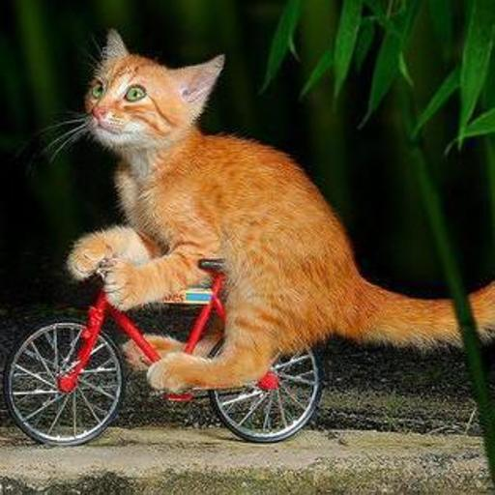

Alexander
Matt
Jon
Ryan
Cole

Slide 3
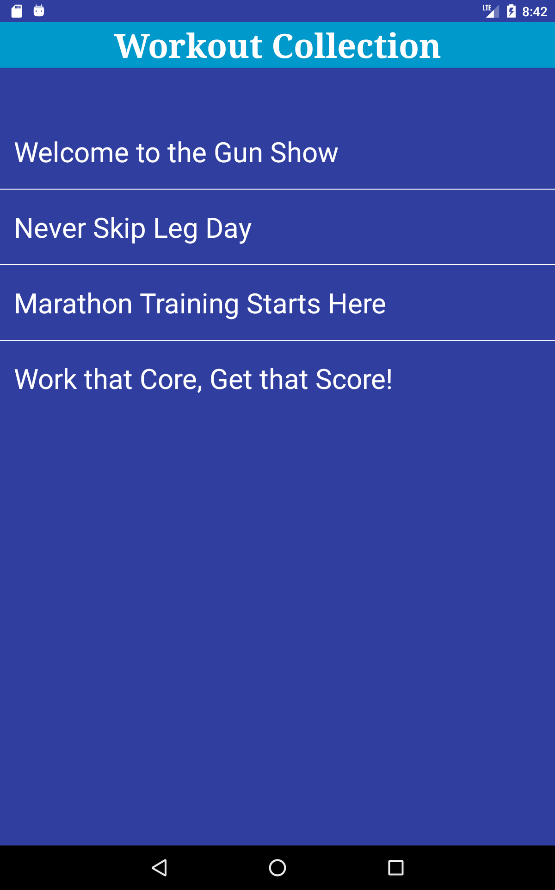
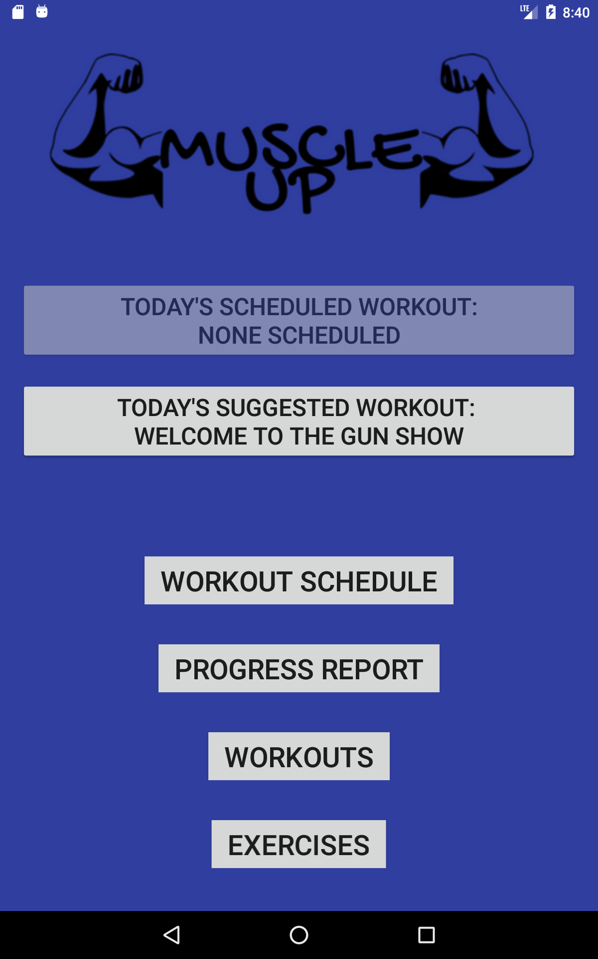
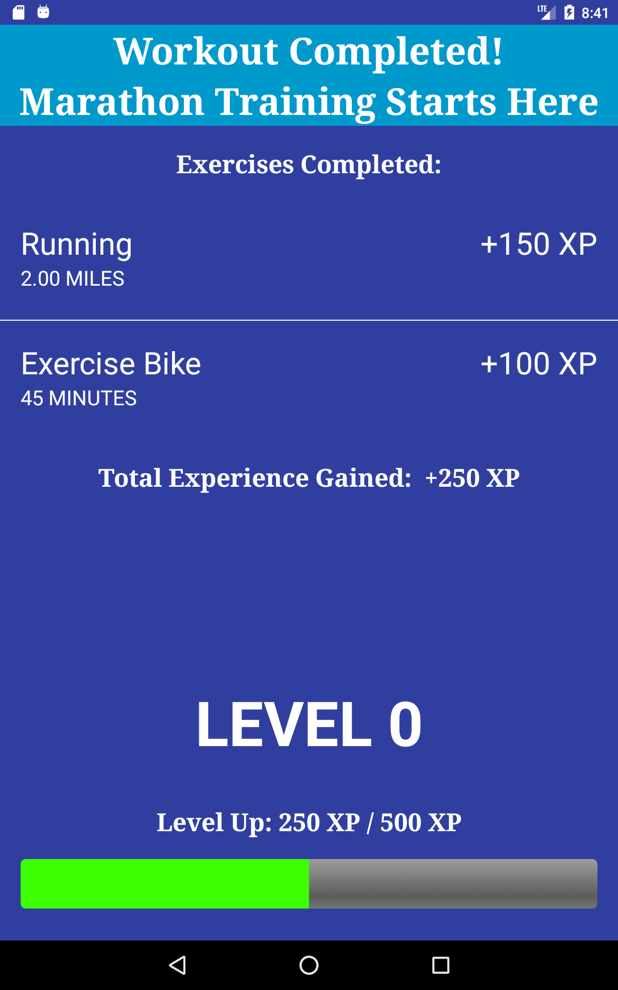

Slide 4


Slide 5
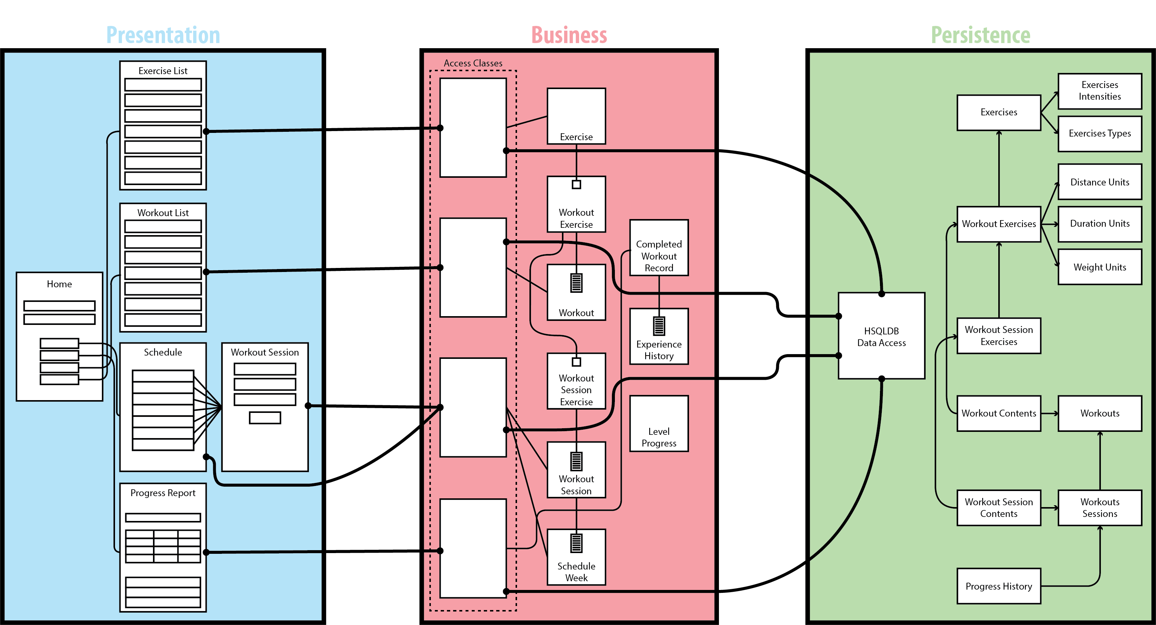

Slide 6
Exercise
Workout
ExerciseDetails
WorkoutSession
WorkoutExercise
WorkoutDetails
ListedExercise
ModifiableWorkout
SuggestedExercise
TrackableWorkout
TrackableExercise
WorkoutSessionExercise

Slide 7
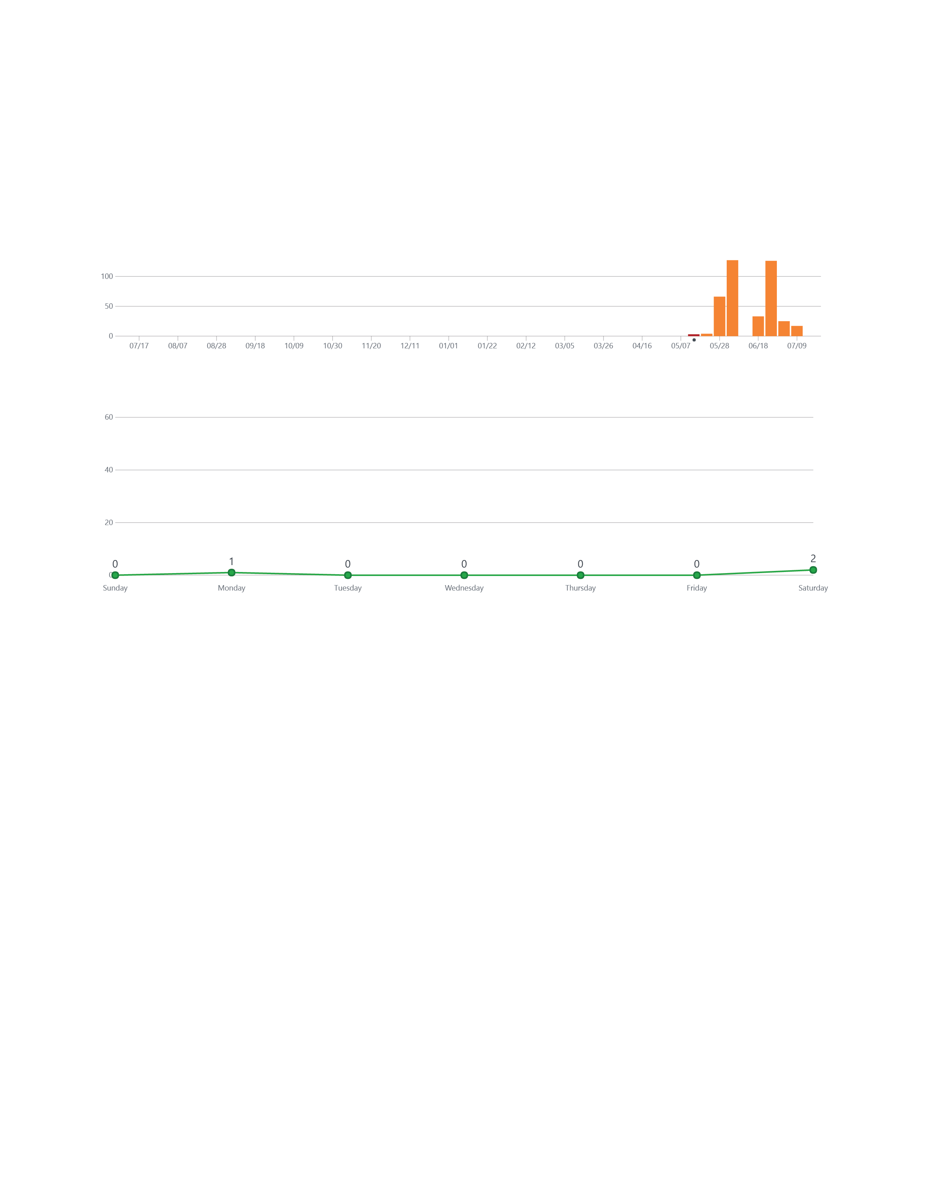

Slide 8
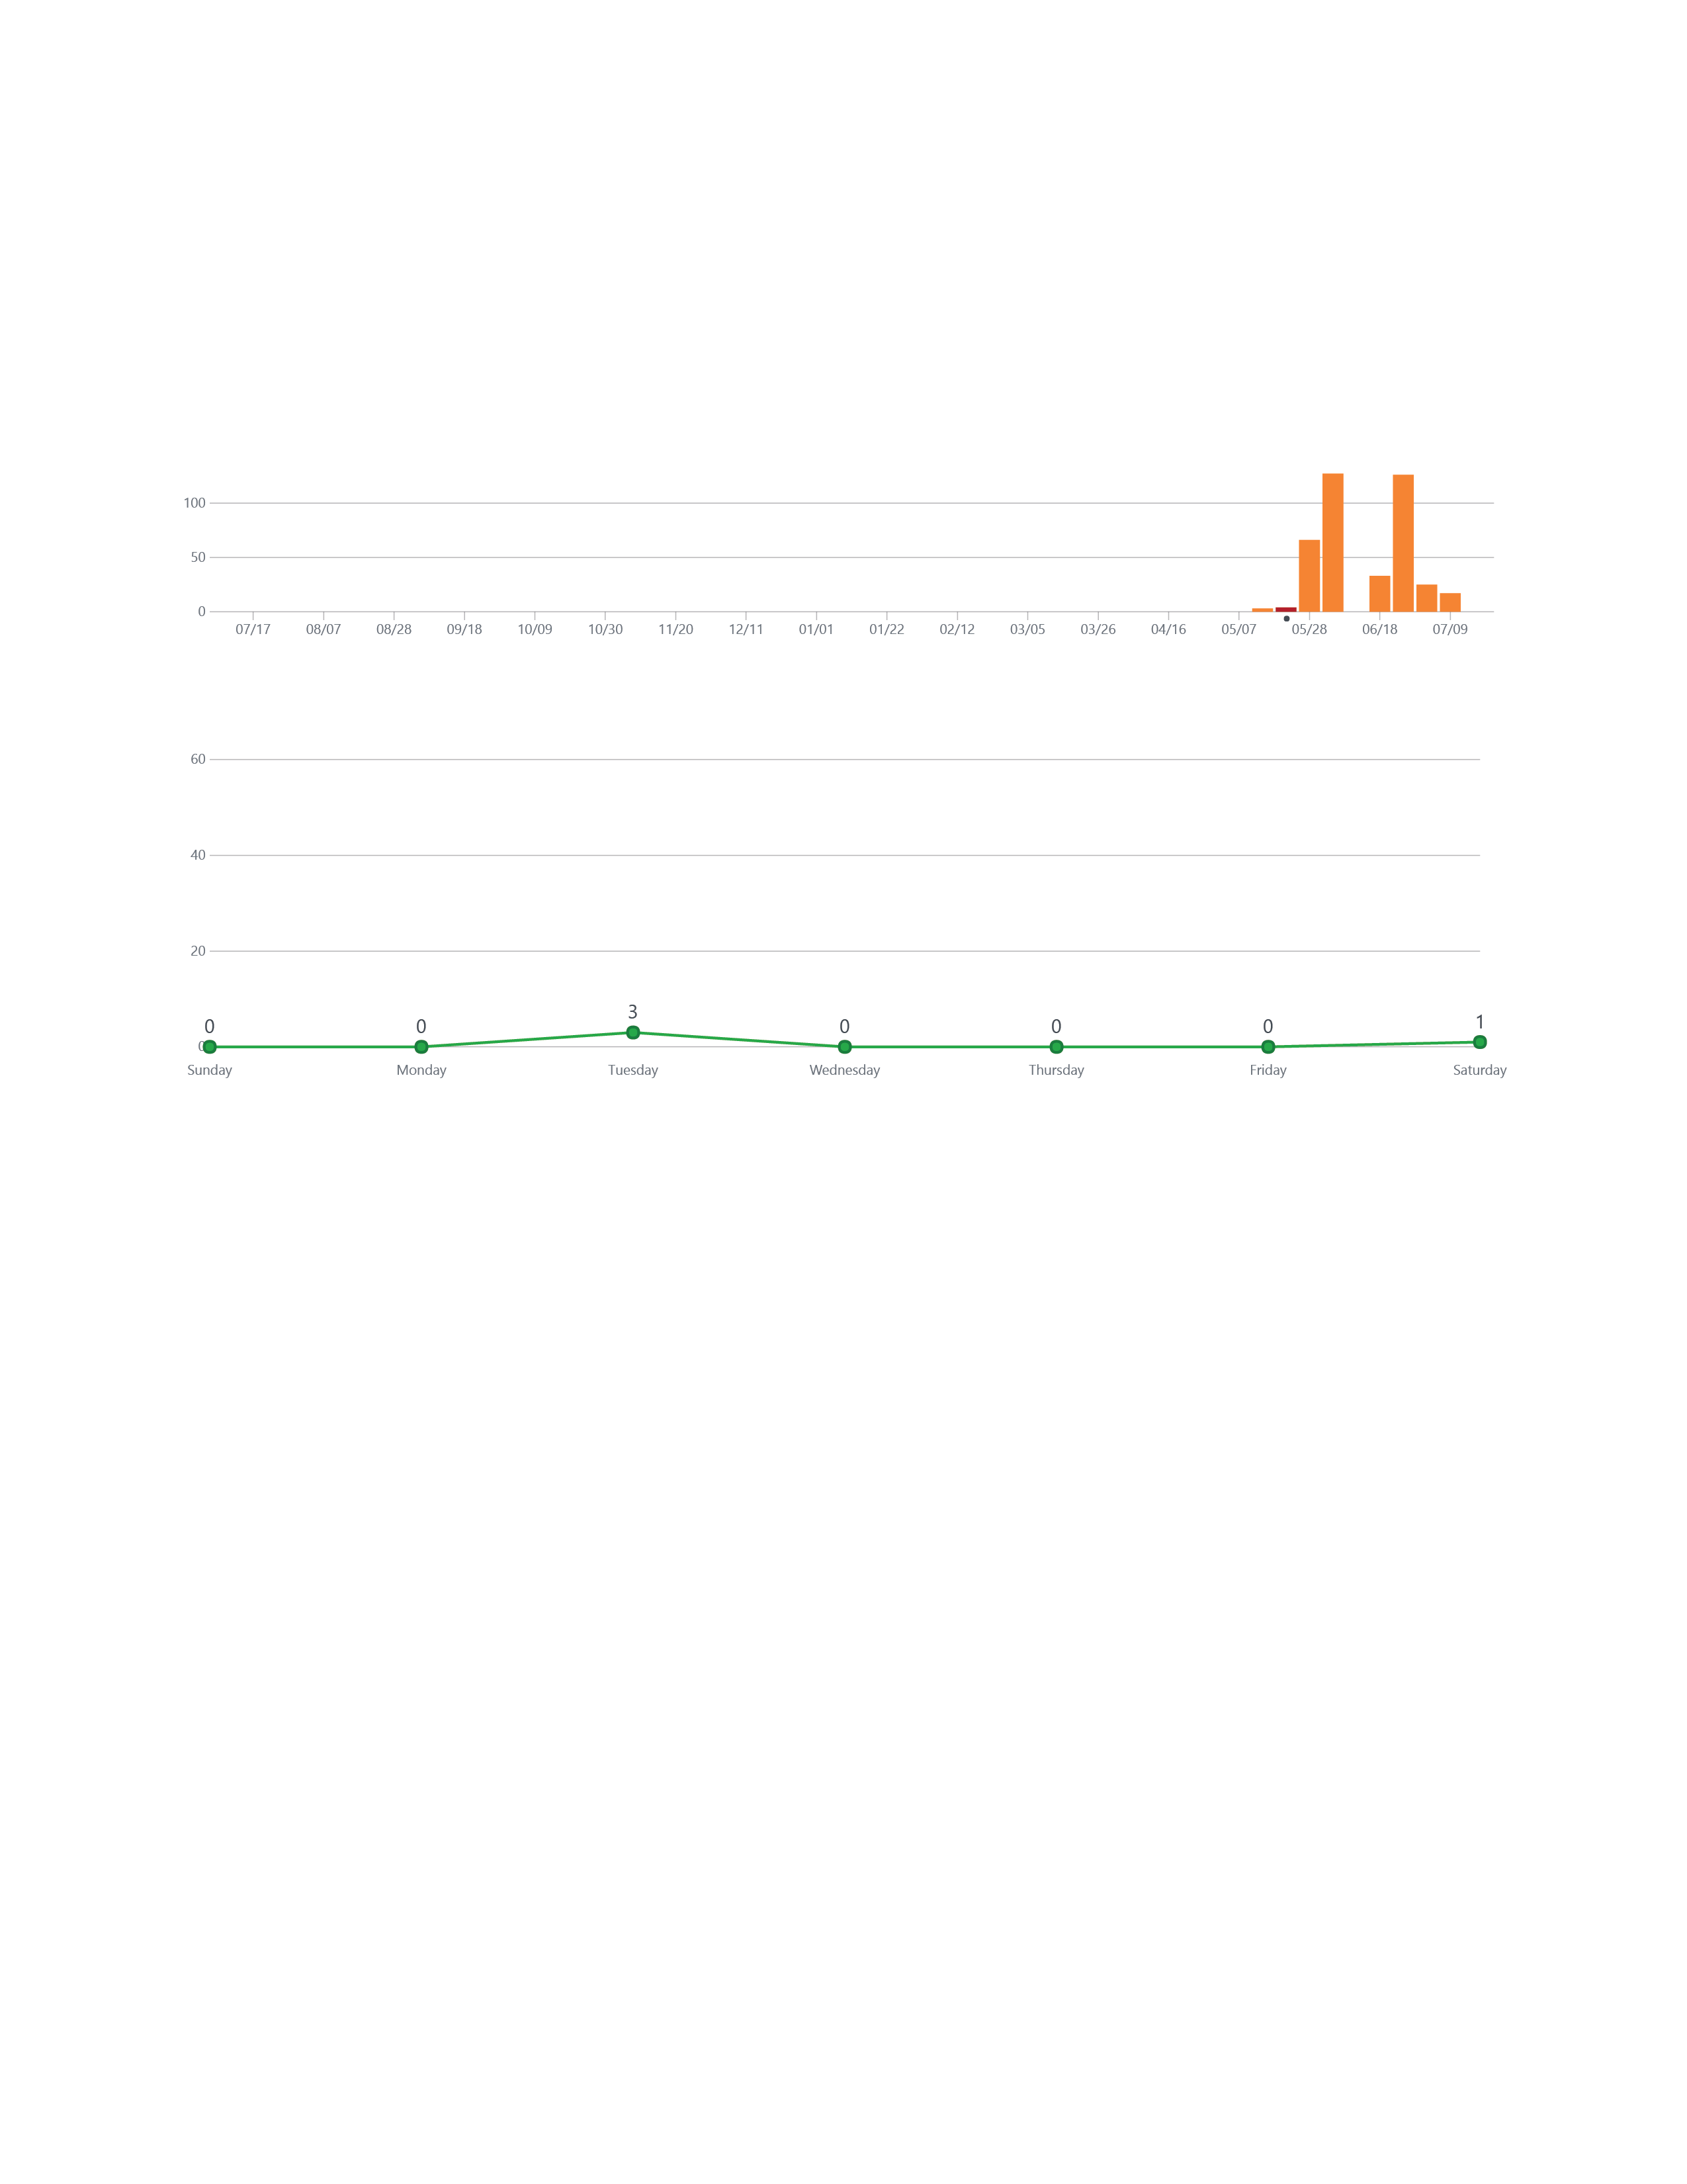

Slide 9
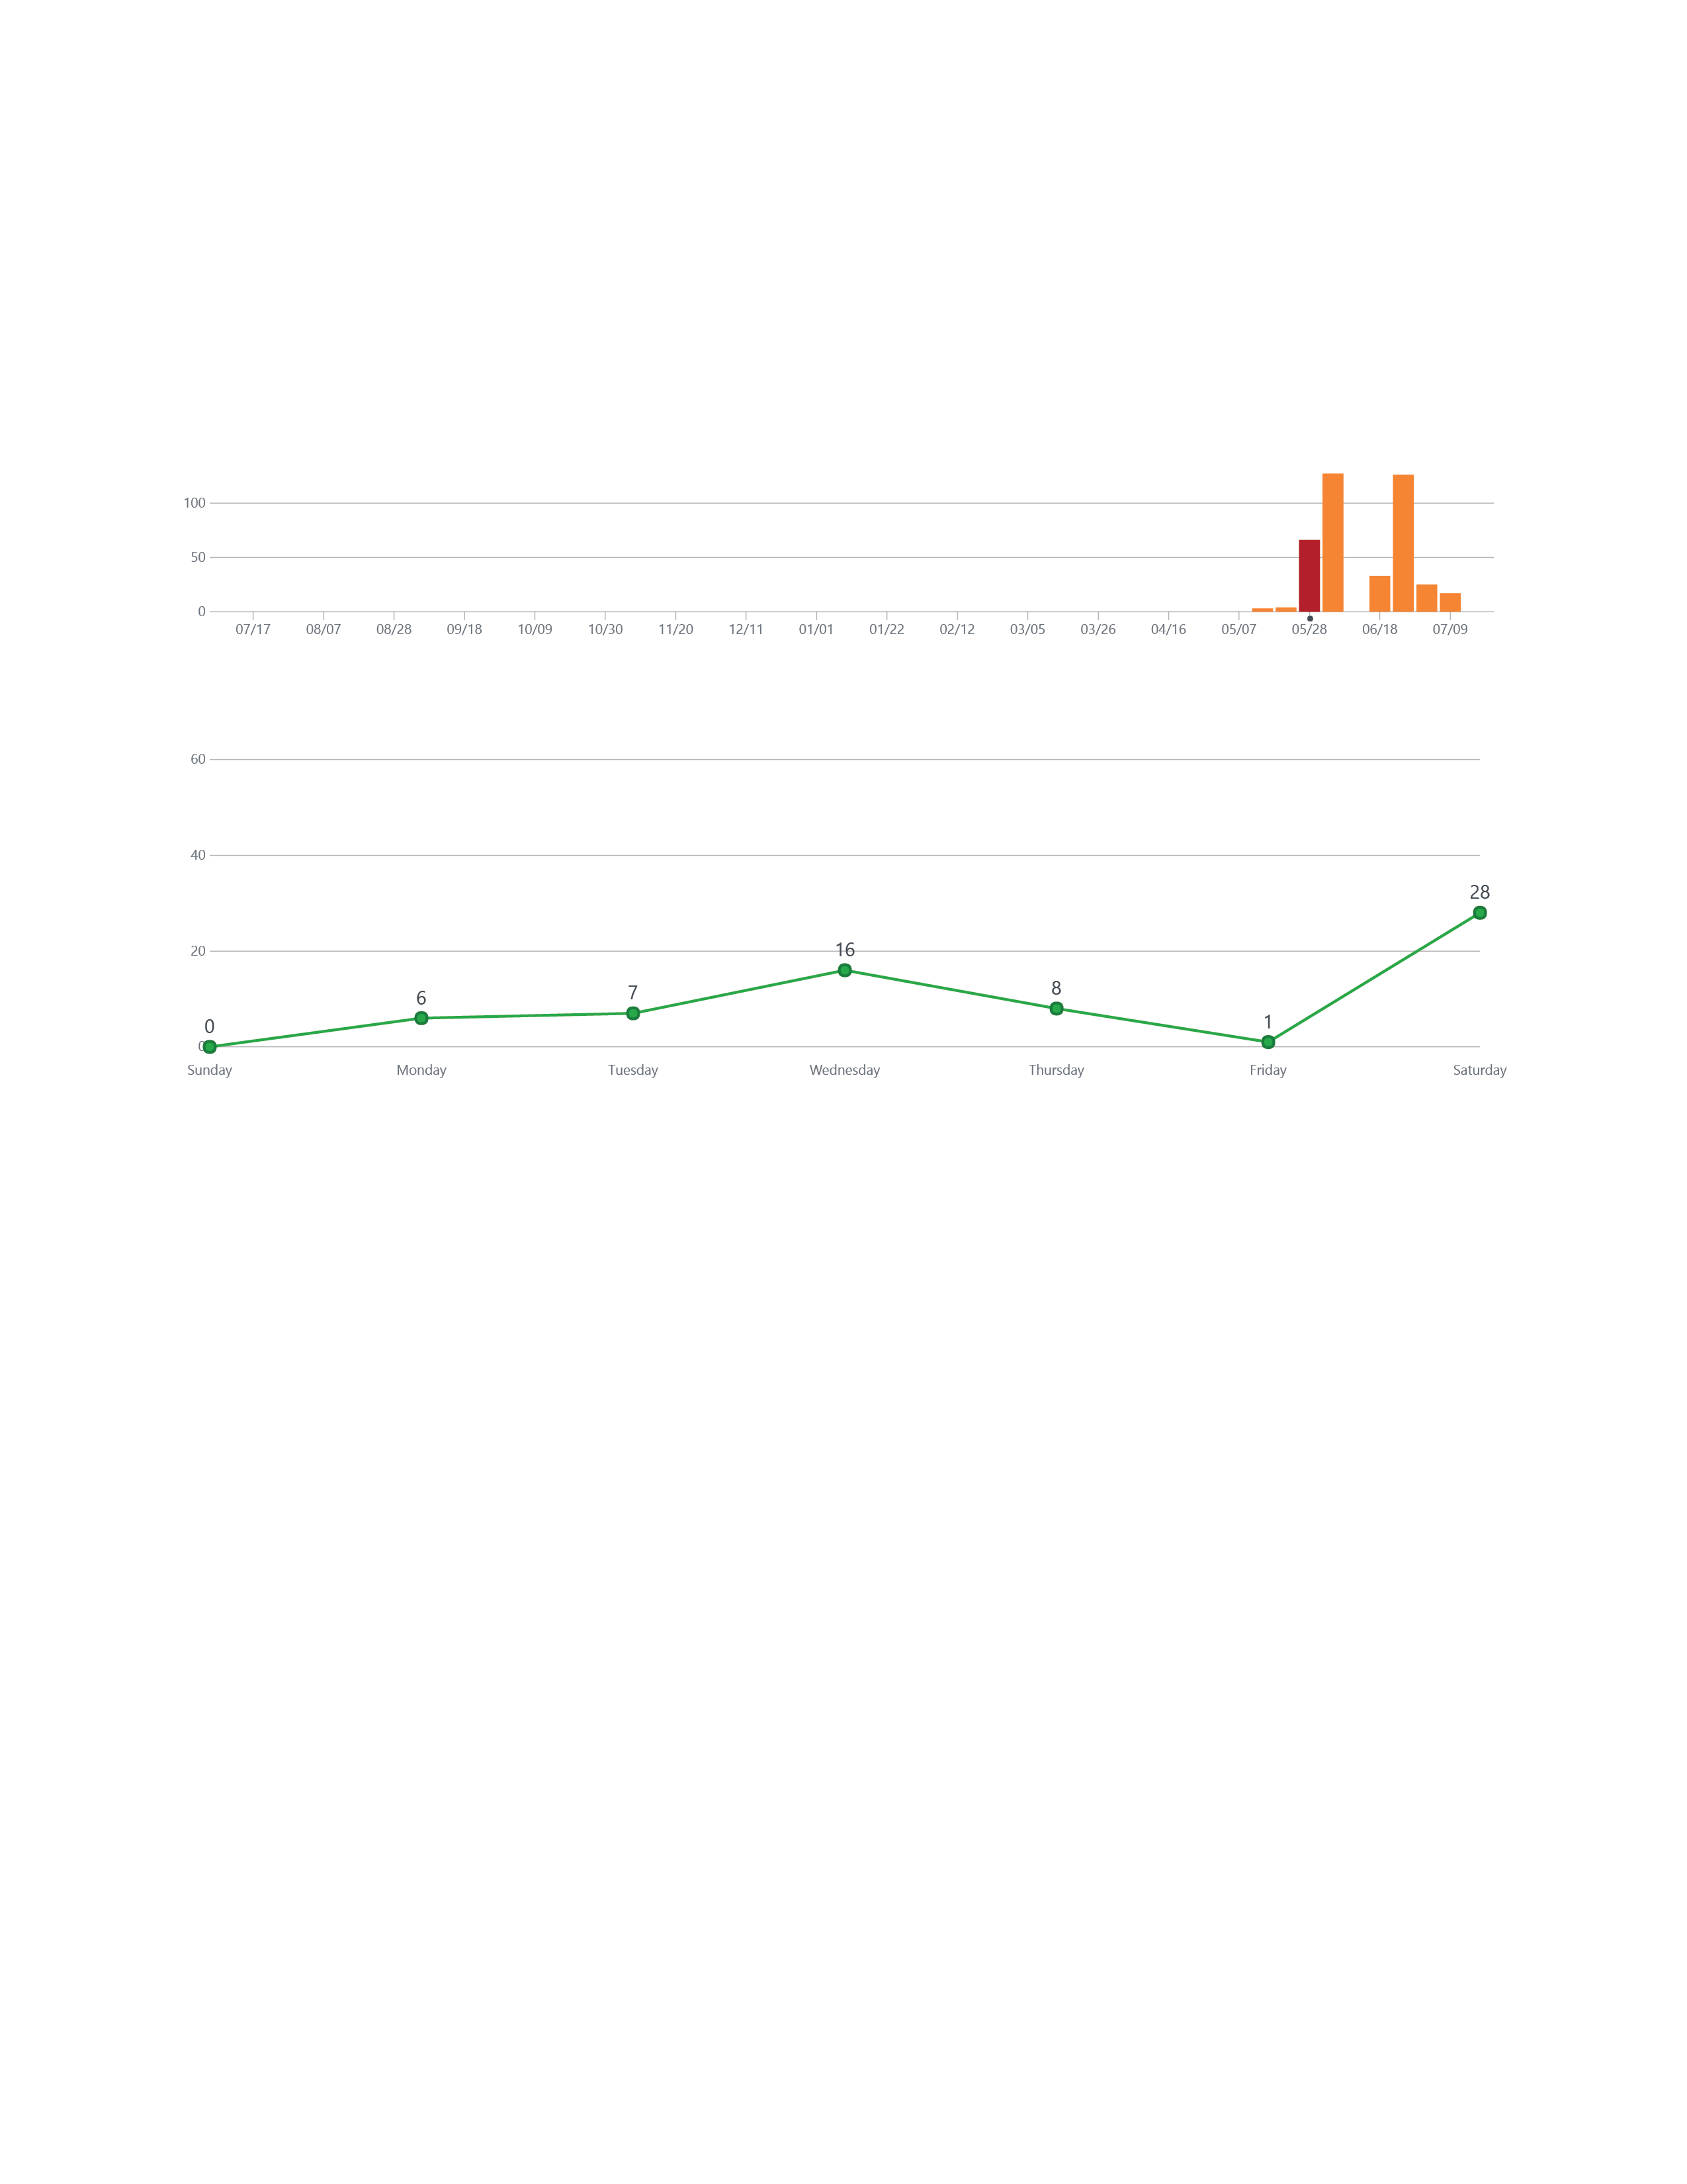

Slide 10
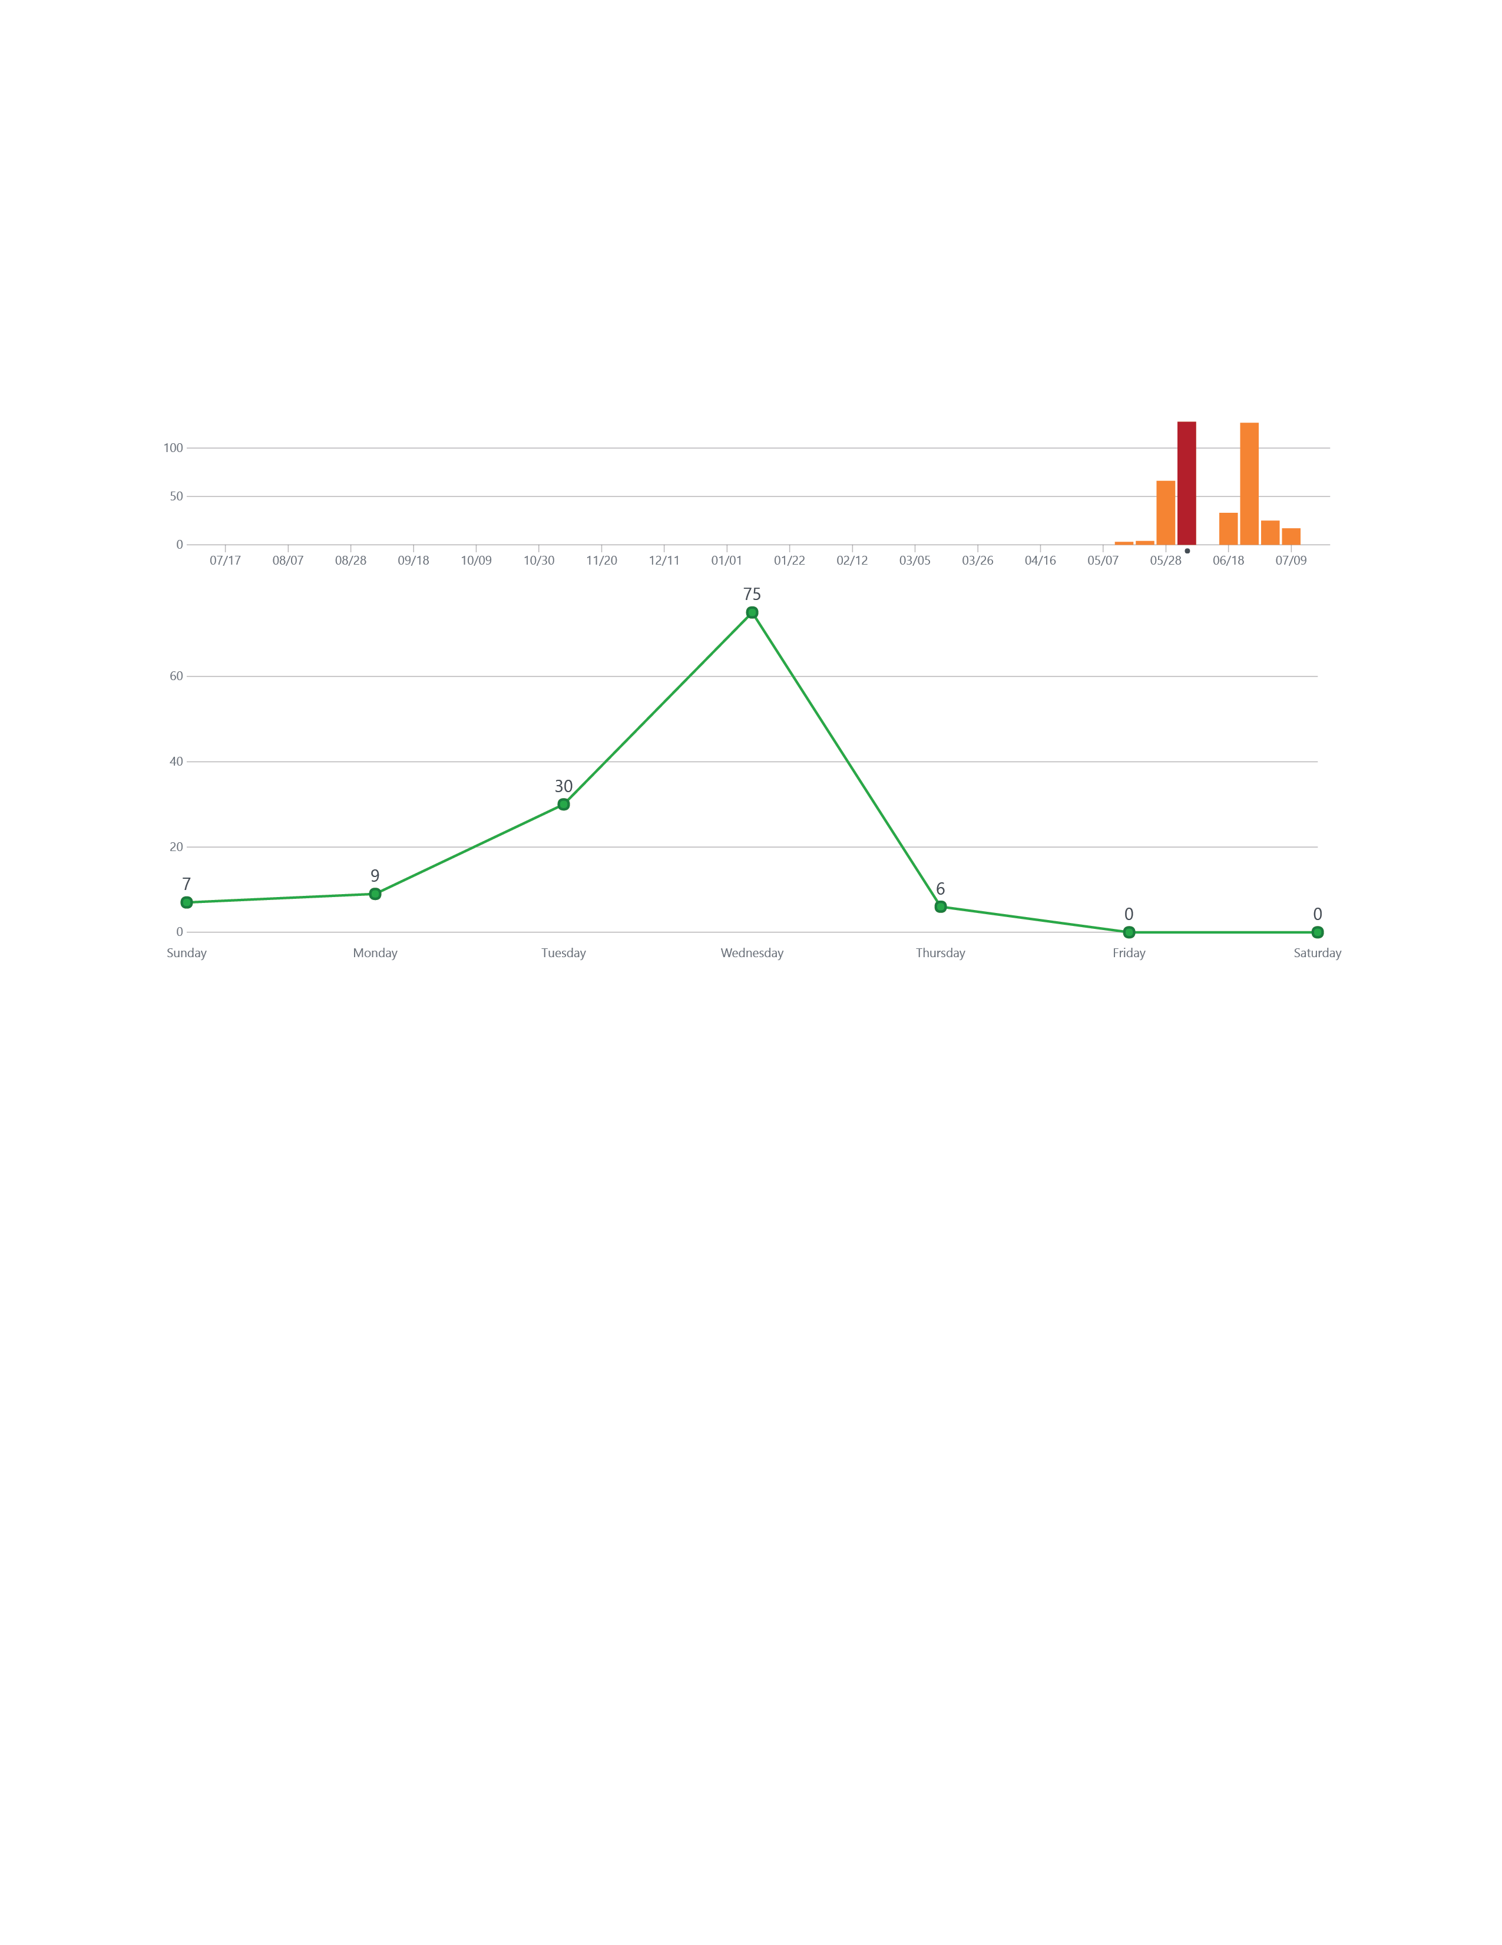
Iteration 1
Due Date

Slide 11
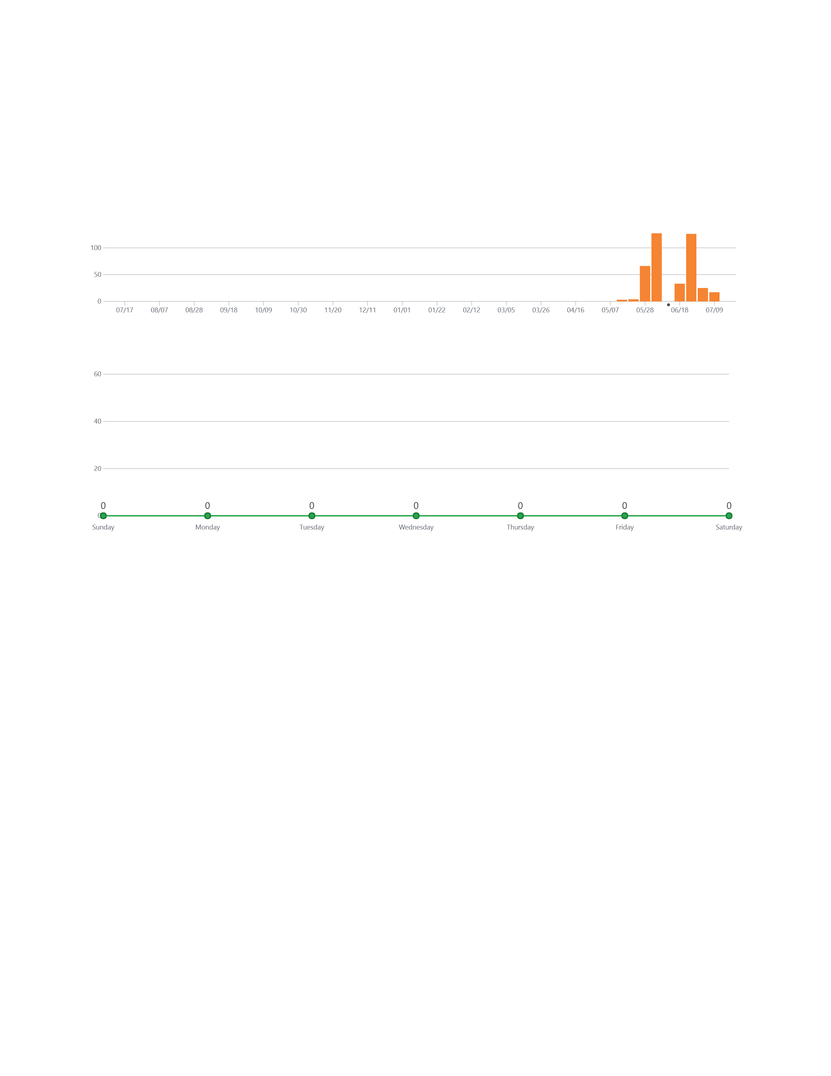

Slide 12


Slide 13
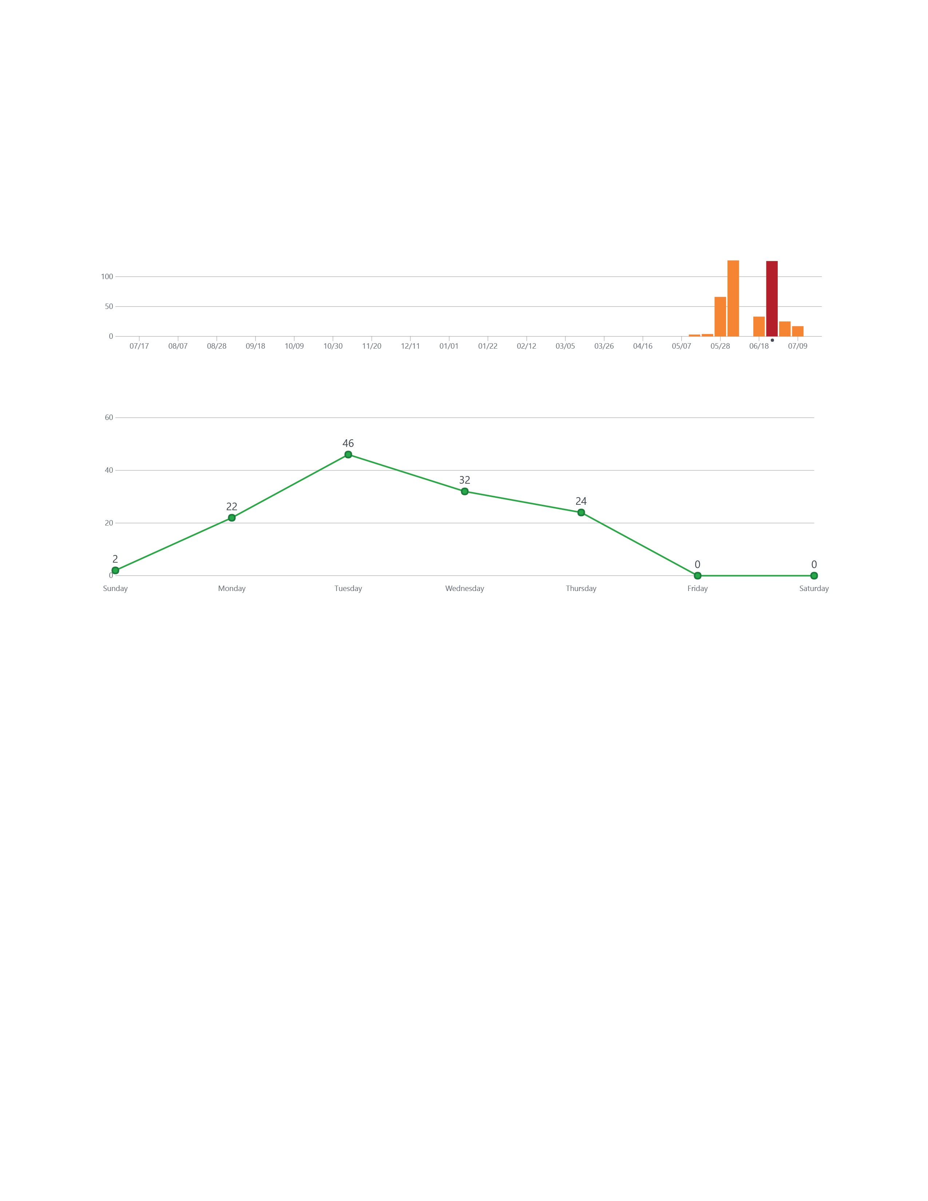
Iteration 2
Due Date

Slide 14
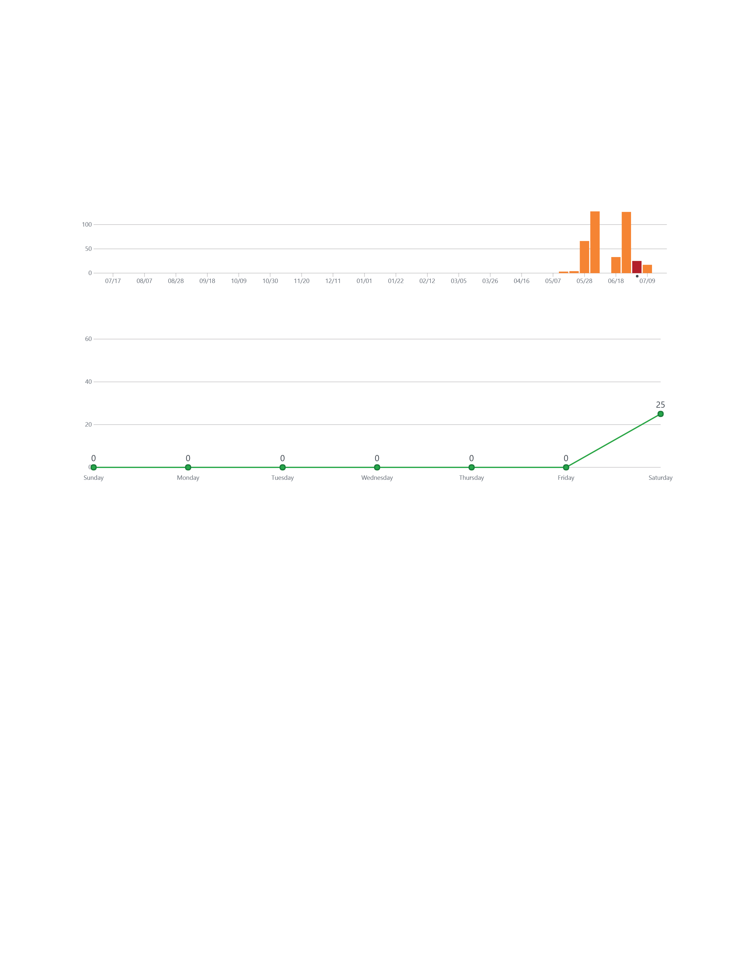

Slide 15
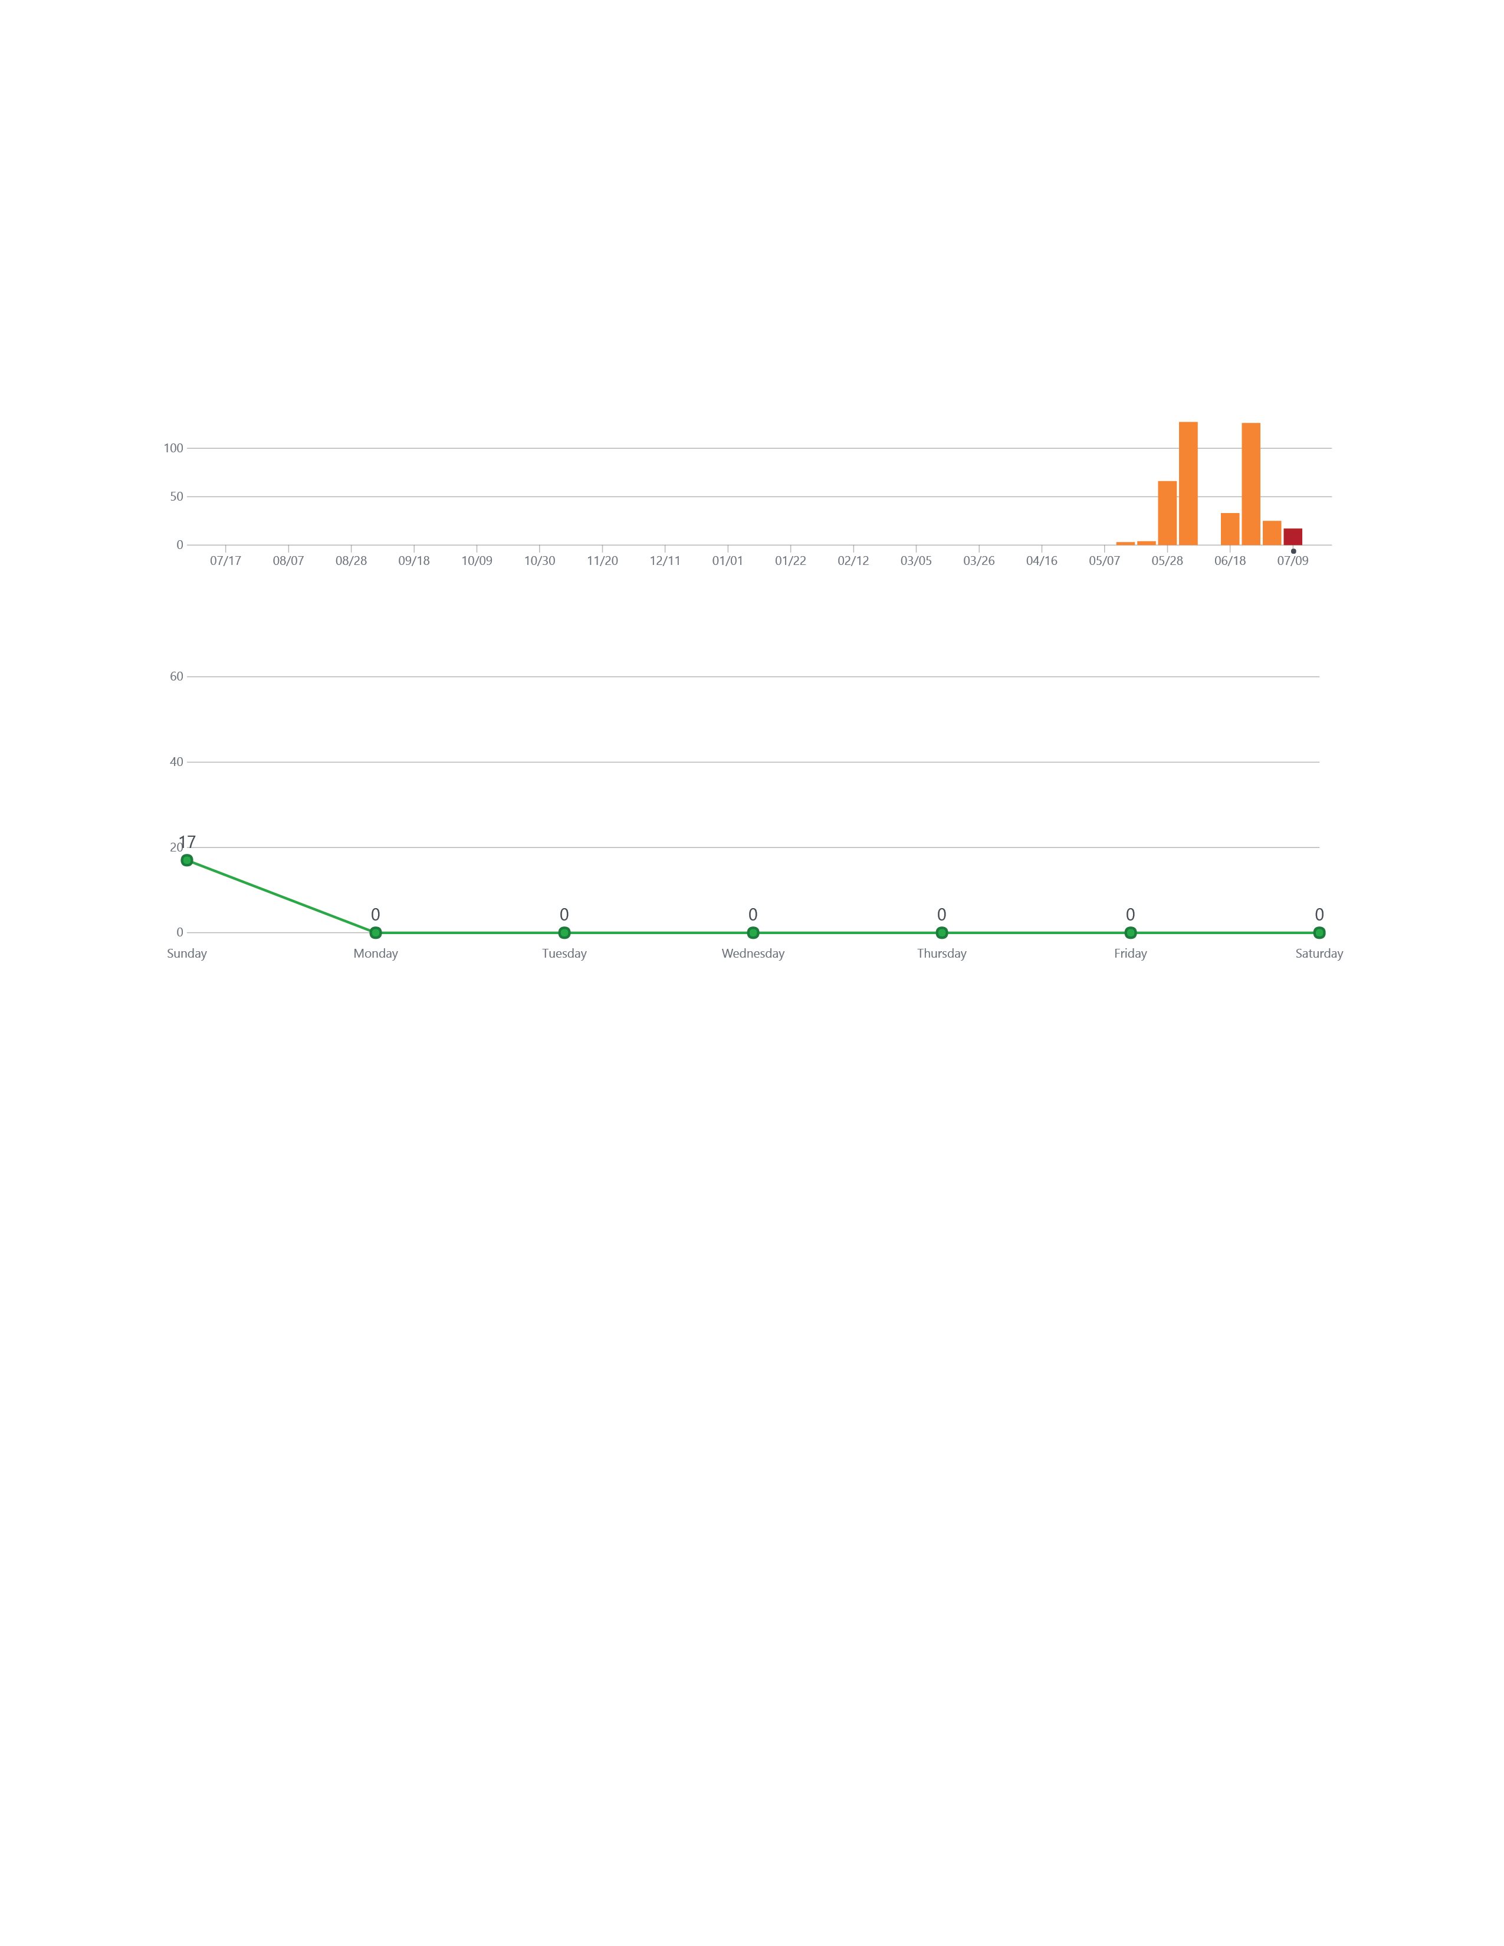
Today
Iteration 3
Due Date

Slide 16
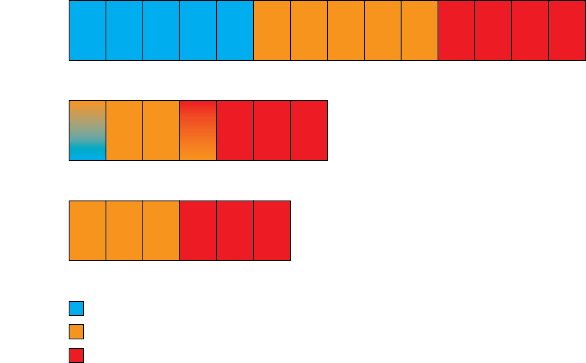

Slide 17
Workout of the Day
User Profile
Workout Summary
Custom Exercises
Sharing Workouts
Challenge Your Friends
Leaderboard

Slide 18
Custom Workouts

Slide 19
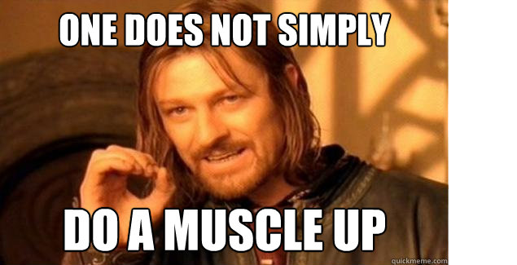

Slide 20
